Slide 1

ERMS/NITA SIT Functional Review
Presented by: Stock-In-Transit Team
Notes:
USS H. S. Truman (CVN-75)

Slide 2
Agenda
What is ERMS/NITA?
How to access ERMS/NITA
NITA SIT Query
Document Listing/Document Listing Links
Parent Child Relationship
Updating POS/POD
Notes:
This training will focus on NITA from the CAV perspective. Including how you, as a CAV user, will access NITA, how you will pull SIT reports, how to post proof of shipment and delivery and how to communicate with NAVSUP WSS utilizing the Comments feature.

Slide 3
What is ERMS/NITA?
NITA (NAVSUP WSS In-Transit Accountability) is:
  A module within the electronic Retrograde Management System (eRMS).
  A conduit for all SIT stakeholders to access, research, and resolve Stock-in-Transit.
  NITA provides:
    Stock in Transit reports.
    The ability to view and update transportation data.
    The ability to add comments; providing a more efficient tool for communication between stakeholders and NAVSUP WSS.

Slide 4

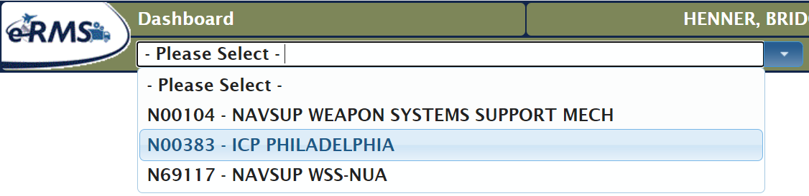
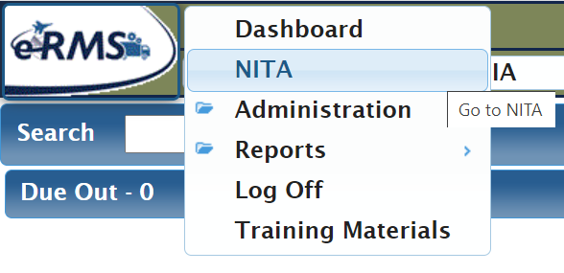
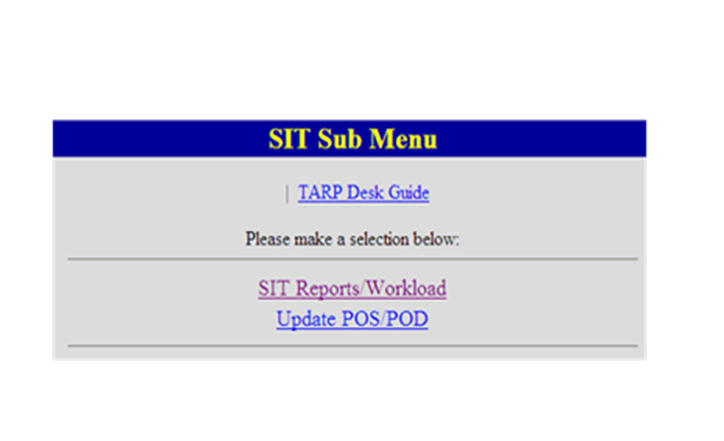
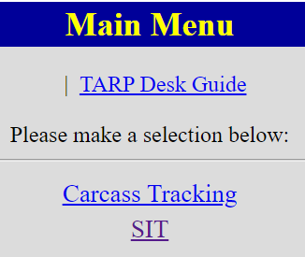
eRMS/NITA Login
https://applications.navsup.navy.mil/erms/Dashboard/Dashboard/Index
1
2
3
4
Notes:
Getting To NITA SIT:
Go to https://mril.navsisa.navy.mil/erms/Login_Banner.asp
Select your user account and click “continue to eRMS”
Click “NITA” from the eRMS Main Menu
Click “SIT” from the NITA Sub Menu
Click “SIT Reports/Workload” from the SIT Sub Menu
If you do not have eRMS or NITA access, you can:
Go to https://mril.navsisa.navy.mil/erms/Login_Banner.asp
Select the “Access Request” link and fill out the web form
Fill out a SAAR form and fax to: 717-605-5703

Slide 5
SIT QUERY PULL

Slide 6
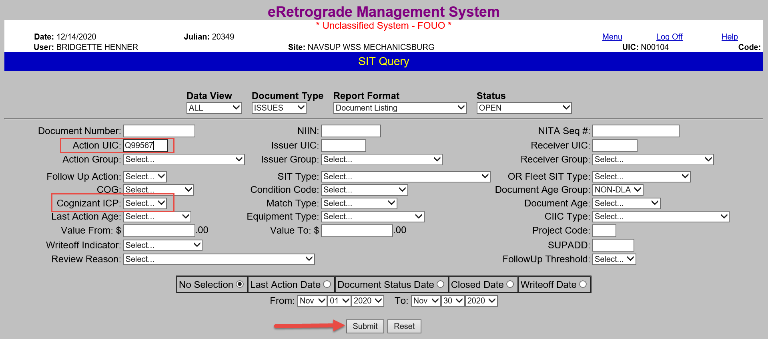
Action UIC SIT Query
Notes:
This is the main SIT Query screen that you will use to pull all of your open SIT, (as well as possibly reviewing your closed SIT).
Most of the fields have pre-populated drop down menus, but you can still manually enter a Document Number, NIIN, or NITA Sequence #. The NITA Sequence # is a unique number assigned to a SIT record (based on the Document Number).
Please note that “Action UIC” is set as the default option. Action UIC is the activity that currently owes an action with regard to an open SIT record.
You can also select the “Issuer UIC” box to look at all SIT records for which you are the Issuing Activity, regardless of who is the Action UIC.
By selecting the “Receiver UIC” box you can choose to look at all SIT records for which you are the Receiving Activity, regardless of who is the Action UIC.
The “Cognizant ICP” heading allows you to choose which WSS’s SIT you want to look at. If you move it to “Select” it will cover everything.
The “CIIC Type” filter let’s you choose a CIIC, (Controlled Item Identification Code) category, (Confidential, Sensitive, Pilferable) You can search specifically for your Classified SIT using this.
Now we are going to go over how a CAV User would go about getting their SIT Workload. The defaults are already pre-set so that you will get all open SIT records where your site is the Action UIC. Simply click “Submit”

Slide 7
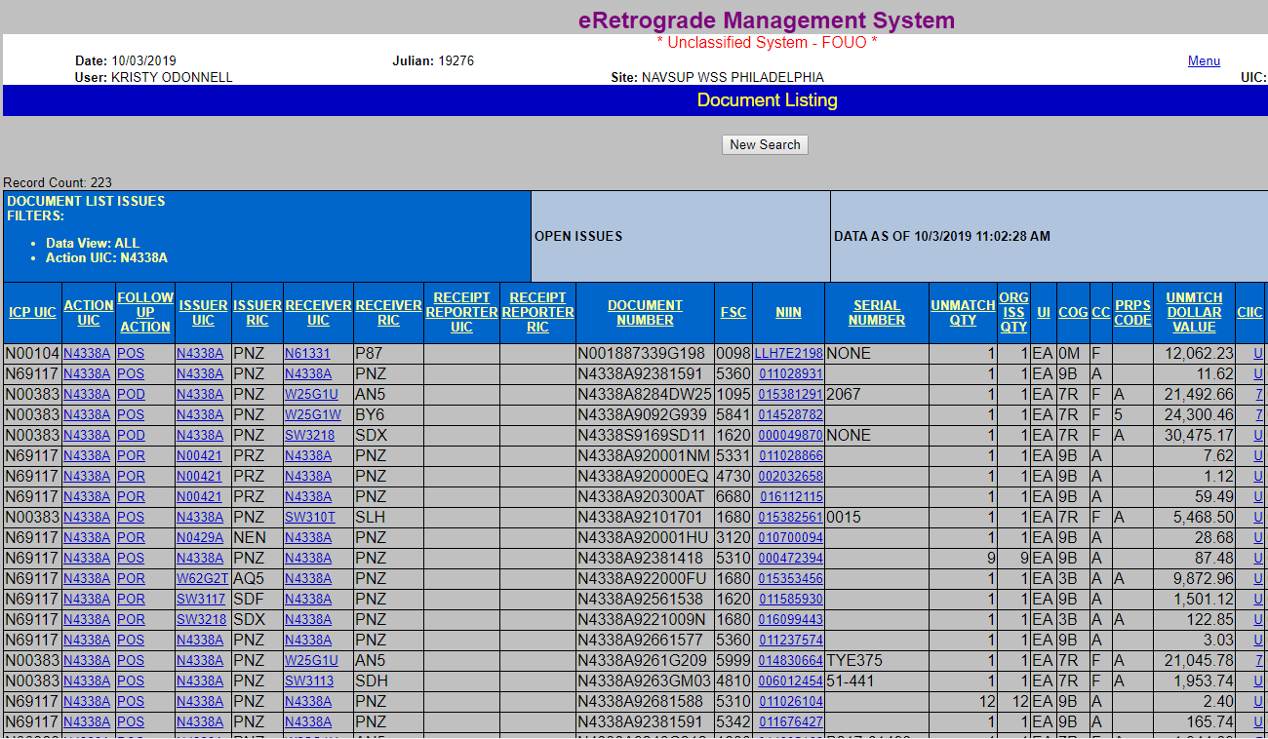
Document Listing
Notes:
The Document Listing reports contain the data needed to identify why open SIT issues are open and what may have gone wrong. The report heading repeats the filters used to generate this report. This report was generated from a summary report’s “POS” link; thus the filter “Followup Action POS” is in addition to the filters used to pull the original summary report.
*Please note that reports are generated in a real time environment and do not remain static for long, especially reports with a followup action of “POS.” Once POS is entered, the record drops from the listing. Noting the date and time a report was generated has new relevance.
Each column of information helps you research the problem.
COLUMN HEADINGS:
ICP UIC – ICP UIC is based on the item’s COG. This is true in ERP also. N00383 is WSS-Philadelphia, aviation items, RIC N32. N00104 is WSS-Mechanicsburg, ship items, RIC N35. N69117 is Retail, consumable items, 9 and 3 COG, RIC NUA.
Action UIC displays the UIC assigned by NITA as expected to take the action specified in the next column. Action UIC is a link to SIT UIC information – the UIC’s name and address. When a user is logged on at the Action UIC level, this column is his own UIC. Supervisors and WSS are expected to use the link.
Followup Action: NITA does not change the basic requirements of SIT tracking: If you are the issuer, you owe POS data. If you are stowing the shipment upon receipt, you owe a receipt TIR to WSS. NITA adds a new capability for CLF ships - if you are the transshipper of ANOTHER ship’s issue, you owe OHA (oh-ha), or “on-hand acknowledgement,” which is actually an additional POS record.
Issuer UIC and Issuer RIC. These columns display the UIC and RIC of the site that reported the D7 TIR, for SIT issues. When the SIT document is an open unmatched receipt, the issuer RIC is the RIC reported on the receipt in the consignor field. Issuer UIC is the RIC’s translation. When you see N00391 and NRP as the Issuer UIC and Issuer RIC, this means the receipt was reported with a blank consignor and ERP categorized it as a SIT receipt.
Receiver UIC and Receiver RIC. Open SIT issues show the final destination’s UIC and RIC in these fields. Initially, these fields are based on the D7K coding: Signal code A, B, C, or D will cause the document number UIC to be the Receiver UIC. Signal Code J, K, L, or M causes the Supplementary Address UIC to populate Receiver UIC. Receiver UIC and RIC can be altered by WSS analysts. If it has been changed, you can see what it was originally further to the right in the Document Listing record. You can see who changed it and why in the BAR display.
Receipt Reporter UIC and RIC. A new feature in SIT tracking, provided by NITA, is WSS now shows users receipt information. For partial match issues and unmatched receipts, receipt reporter is the site that TIR’d the “D6” receipt. These fields are blank when the record is an unmatched issue with no receipts reported.
Document Number: The document number column displays open SIT without regard to Service Code of the document number. All ships and MALS requisition new AVCAL allowances with an “N” service code; those SIT issues display in document number sequence, beginning with the second character. Suffix code is not collected nor displayed, nor is it a matching field. The link is demonstrated in subsequent slides. If there is more than one Child record open, the document number displays for all the open Child records where the logged on UIC is the Action UIC.
FSC and NIIIN: The open SIT issue’s NSN is displayed in two columns – FSC and NIIN. This allows the user to sort a spreadsheet by NIIN, which is useful if spot inventory is needed to help determine if the shipment is onboard.
Serial Number: NITA provides a new detail not available in old SIT tracking programs: a DLR item’s serial number. NITA collects item serial from eRMS retrograde shipment reports and from DLA receipts for a select group of DLA UII items.
UNMATCH QTY: NITA specifies the quantity per Child record needed to close the SIT child. The unmatched quantity field is determined by subtracting a child record’s receipt quantity from the child’s issue quantity. Because of the potential for several child records per document number, rely on the BAR to accurately analyze total quantity issued per document number compared to total quantity received.
ORG ISS QTY: Original issue quantity per Parent record, compared to the unmatched quantity per child helps you understand what was reported issued and what has been collected as received. For example: The record with original issue quantity of 10 shows unmatched quantity of 7, so NITA has accounted for qty 3. You would see how the three were accounted for on another child record, which would be closed.
UI –COG-CC. Three material data elements display per SIT issue or SIT receipt. The unit of issue, COG, and condition code displayed reflect WSS’s materiel data at the time the TIR posted. Pay attention to the condition code of the SIT tracked document – there may be both an F condition and A condition return on the same document number, both being tracked.
PRPS Code: Purpose Code is a field WSS analysts need to post file corrections.
UNMATCH DOLLAR VALUE: A SIT issue’s unmatched dollar value is the product of the unmatched quantity times the item’s unit value.
CIIC – Controlled Item Inventory Code is a critical field in open SIT issues. If a shipment is classified in the Sensitive or higher CIIC groups, it must be accounted for at final destination within 5 days of delivery.

Slide 8
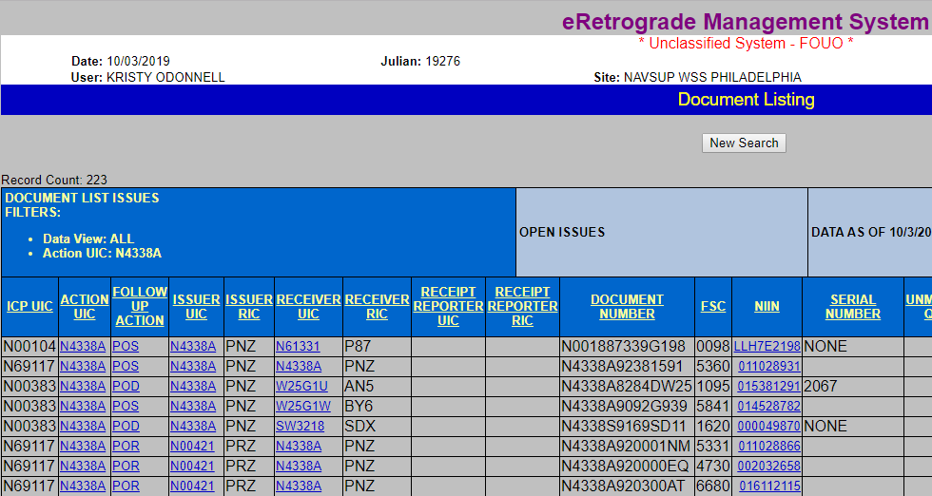

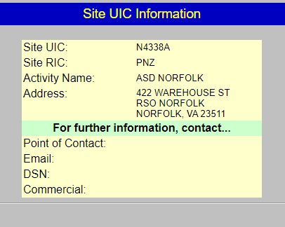


Notes:
At this point, we are going to discuss some of the additional information available to you while using the links in NITA.
Click on the link of the ISSUER UIC, (in this example, V21879), to view the Activity information for that UIC, which includes the Activity Name, address, and Point Of Contact information.

Slide 9
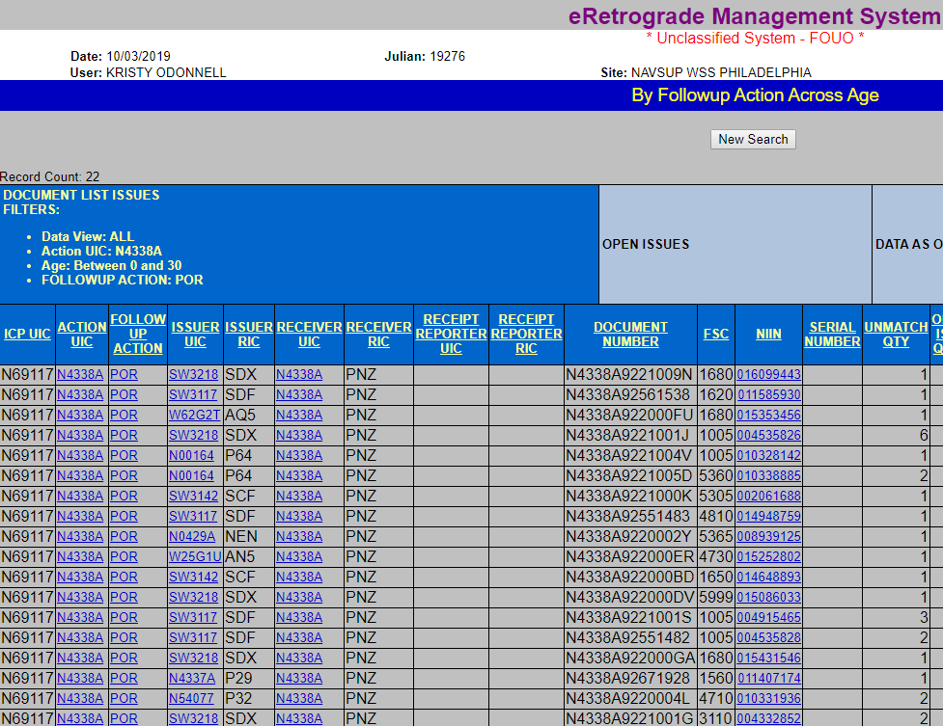
You must enter Receipt into your Business Logistics Application (BLA)
Notes:
Clicking on a link within the Follow Up Action column will have different functions, depending on the actual follow-up action shown. For this example, the Follow-up Action is “POR”, (we will cover “POS” and “POD” in greater detail later in this training). Since the only action that can close a SIT issue is a TIR, (usually a receipt TIR), a message is displayed that reads “You must enter Receipt into your Inventory System”. If for some reason, you cannot process a receipt, you can add a Comment and request a WSS response. We will cover adding a Comment later in this training.

Slide 10
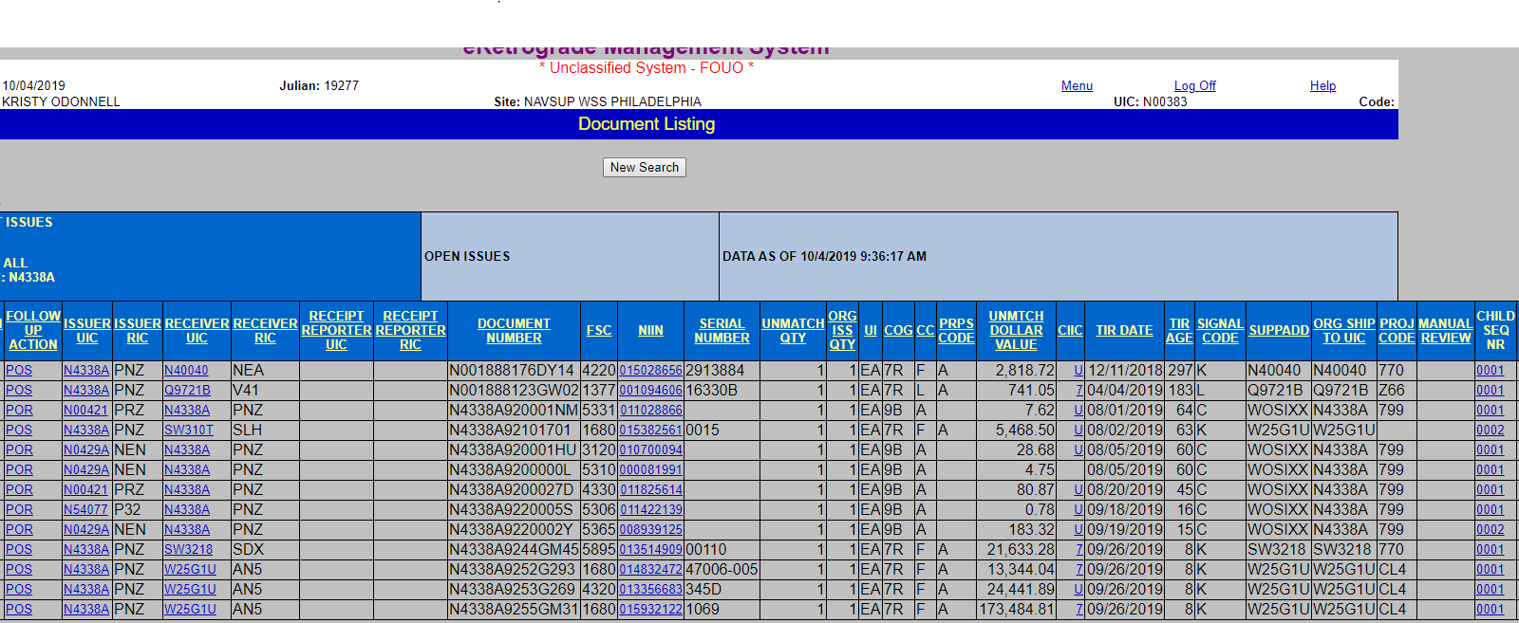

Document Listing Drill Down
Notes:
From this screen you can also drill down into the child record to view more information about a specific document.

Slide 11
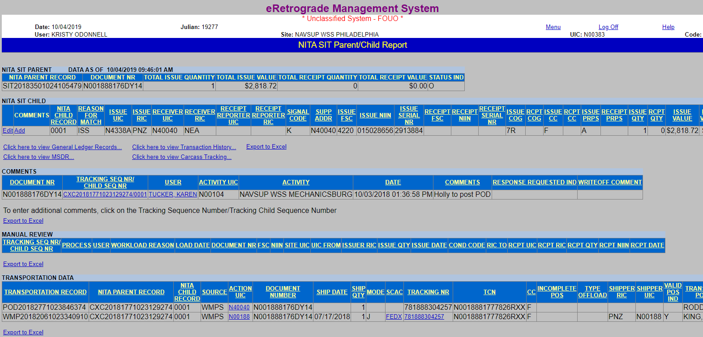
Document Listing Drill Down
Notes:
This screen will come up where you can view comments and transportation data.

Slide 12
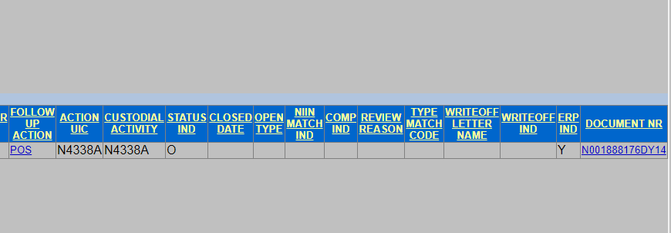

NITA SIT PARENT/CHILD REPORT
As you scroll all the way to the top right of this screen, you can click into the document number highlighted in blue.
Notes:
You are able to click into the document number all the way at the end of the NITA SIT CHILD bar, which will take you to Document History in ERMS.

Slide 13
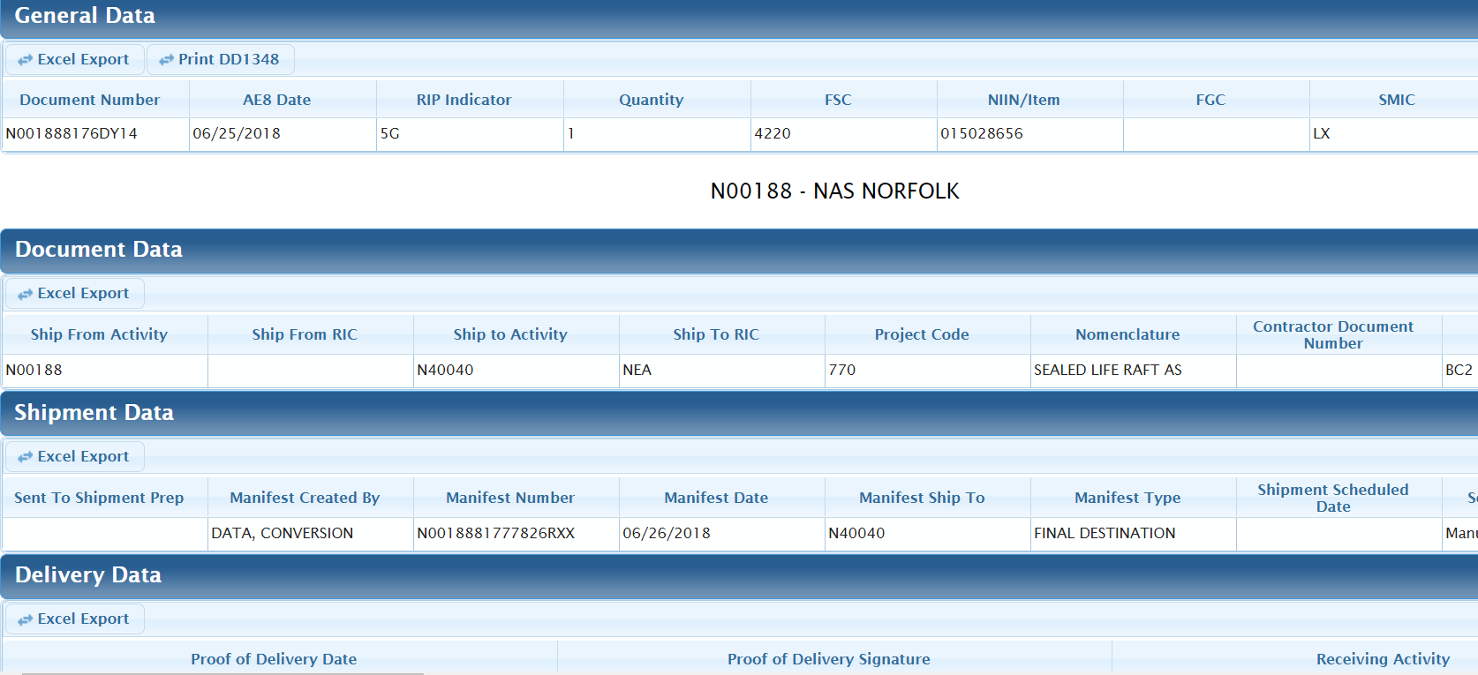
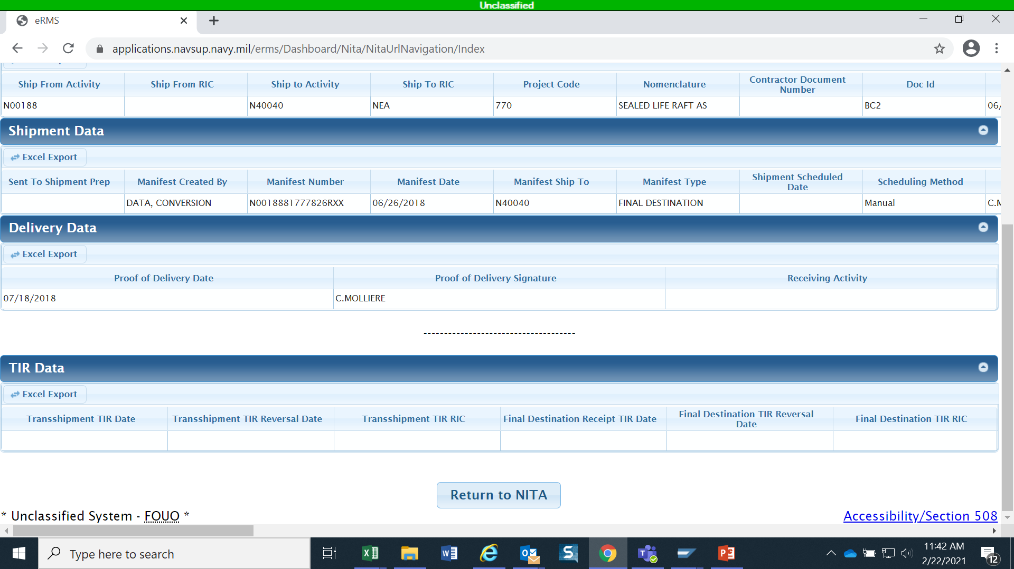
Document History Screen
Notes:
This is another place where you can view SN, part number, NSN, transportation data and print a 1348.

Slide 14
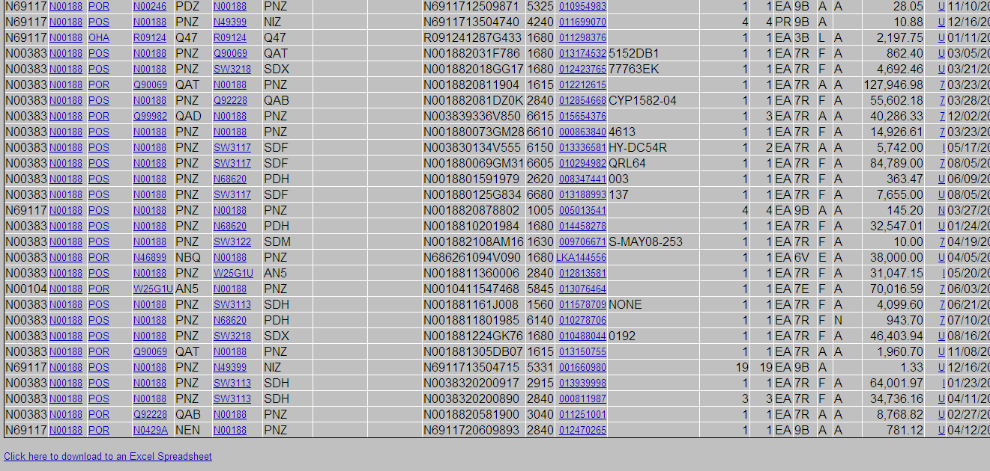
Document Listing
CLICK HERE
Notes:
Going back to our original SIT workload pull in the Document Listing screen. We want to move to the bottom of the page where the Document Listing report has a link at the very bottom to open up excel.
As a helpful tool for working SIT (and keeping track of your workload), you can download the Document Listing to MS Excel.

Slide 15
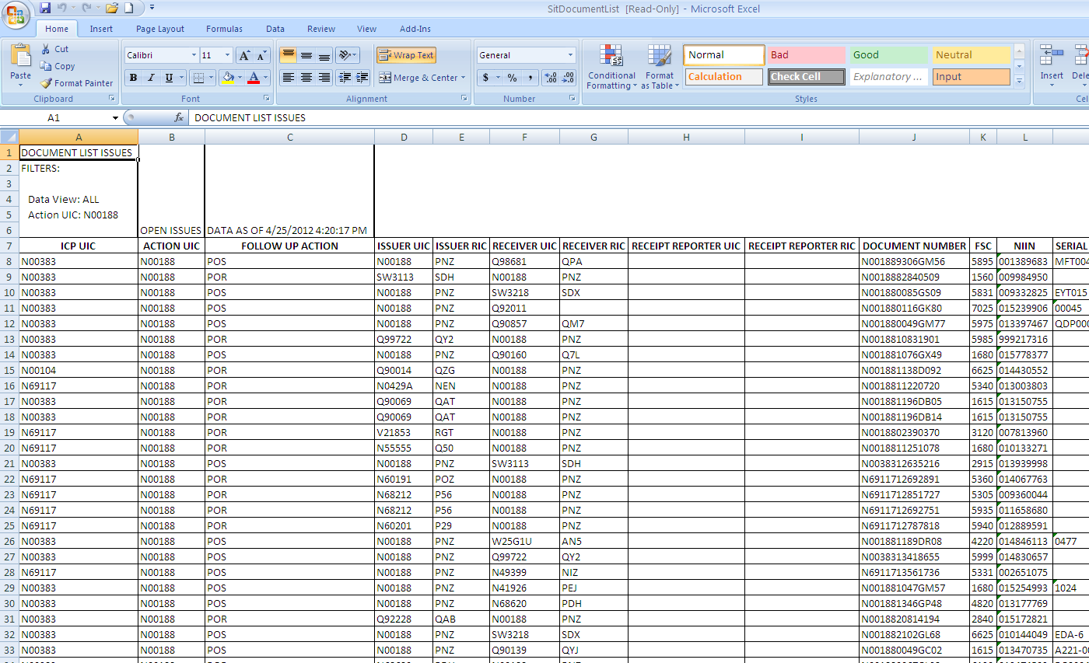
Document Listing
Notes:
The “Follow Up Action” heading allows you to choose to look at SIT for a particular type of required Follow Up Action, (or what is owed).
POS = You owe “Proof Of Shipment”
POD = You owe “Proof Of Delivery”
POR = You owe “Proof Of Receipt” (D6K receipt TIR)
OHA = You owe “On Hand Acknowledgement”.
*Please note that leaving Follow Up Action, (or any other menu option), as the default option “Select” will give you all of the options under that category.

Slide 16
Parent/Child Relationship
Parent/child relationship
  Parent record is based on document number
  Individual child records established as needed when data varies
    Partial quantity issued (split shipment)
    Partial receipt posted
  Intent is to do as little tracking as necessary
    E.g., if 7 assets are issued and 6 are received, there may be two child records.
    Only the record with a quantity of 1 will display as open SIT and require action.

Slide 17
Updating Proof of Shipment/ Delivery

Slide 18
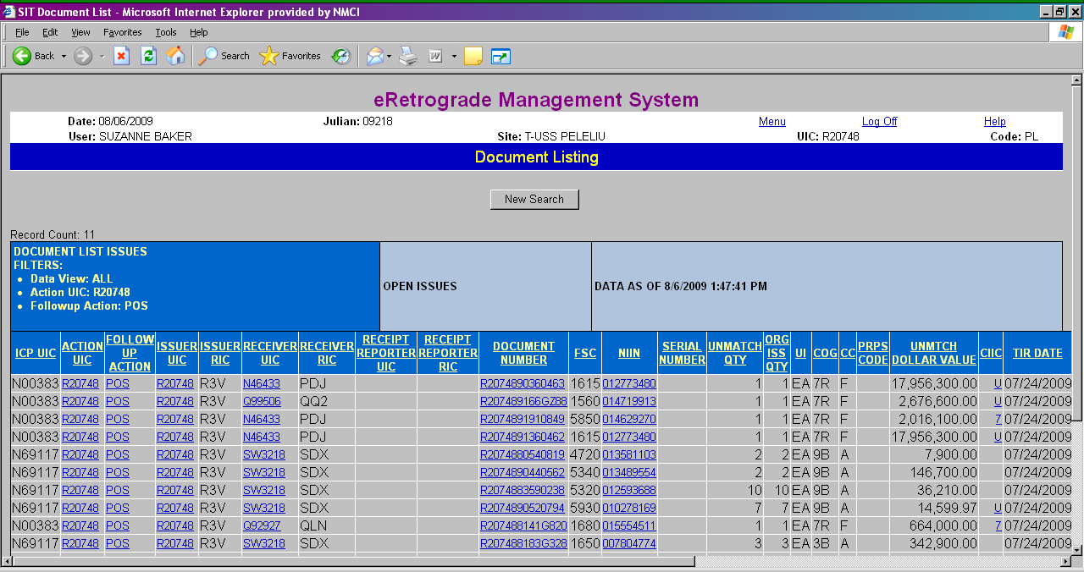
NITA SIT POS Entry from Document “POS” Link
CLICK HERE
Notes:
the “POS” link from the Document Listing are the easiest ways to enter POS/POD, since you will not need to manually enter a Tracking Seq # or a Tracking Child Seq #.

Slide 19
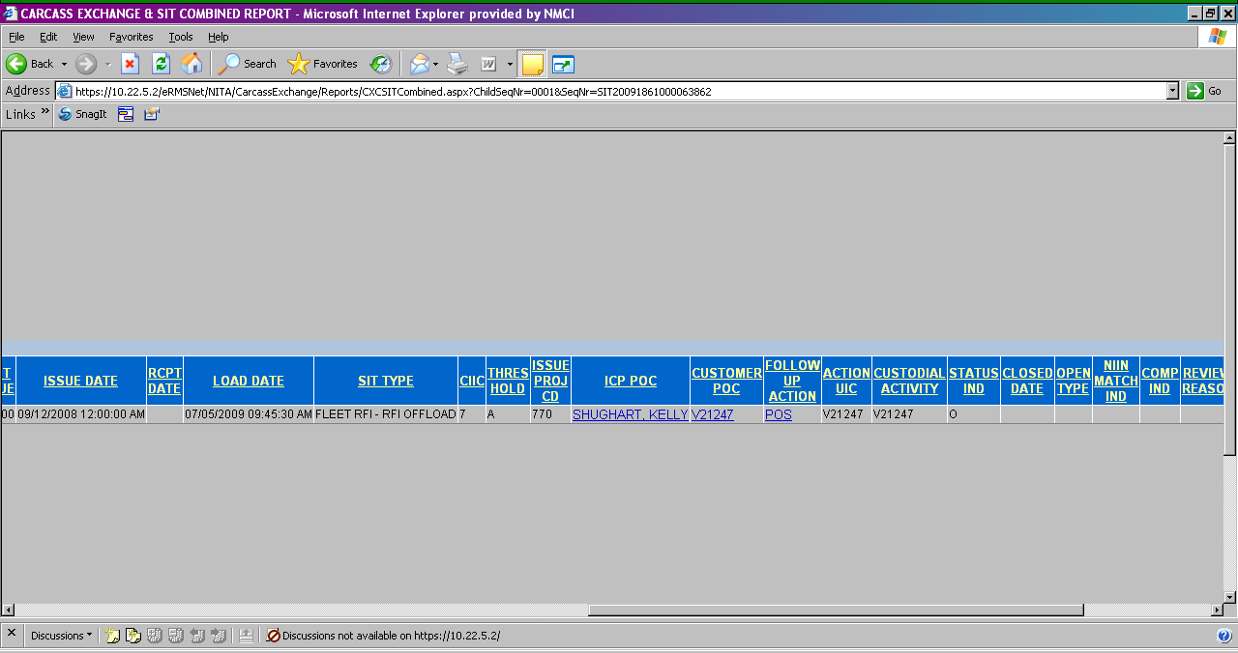
NITA SIT POS Entry Child Record “POS” Link
CLICK HERE
Notes:
You can also enter POS from the Child Record “POS” link. This, along with ****next slide****

Slide 20
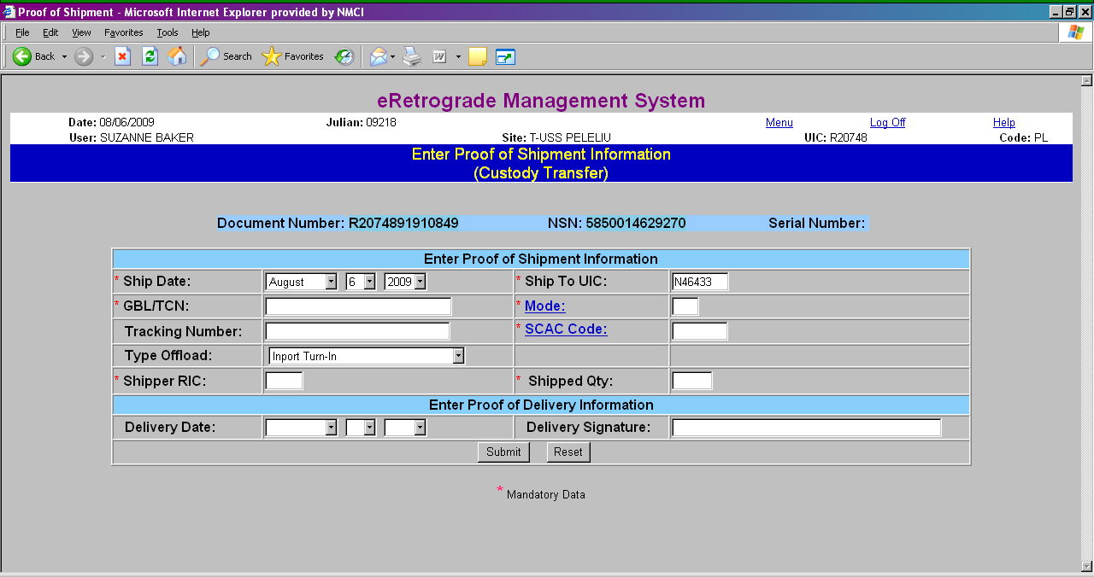
Update POS/POD
Notes:
Either way that you decide to enter POS/POD will take you to the “Enter Proof of Shipment Information” screen.
*Please note:
1. There are several fields marked with an asterisk that are mandatory for ALL shipments.
2. The “Ship Date” must be the actual date that the material was physically shipped, (not the date that the POS/POD information is being entered, nor the date that the issue was TIR’d to WSS).
3. The “Ship To UIC” defaults to the receiving activity as reported on the original issue TIR, however, you must enter the UIC of the actual site that the material was shipped to, including an intermediary site, (i.e. when you use ATAC transportation, the “SHIP TO UIC” must be the UIC of the ATAC Node or Hub that took custody).
4. The “GBL/TCN” field should only contain a TCN, (Transportation Control Number), not the GBL number or other carrier tracking number, (a future enhancement is planned to change this field name to “TCN”).
5. The “Mode” field, (link covered later), is a mandatory field.
6. The “Tracking Number” field is where you enter the tracking number provided by the carrier, (or GBL number if the carrier uses that number to track shipments instead of their own tracking number).
7. The “SCAC” field, (link covered later) is also a mandatory field.
8. The “Type Offload” field is automatically set at “Inport Turn-In”
9. The “Shipper RIC” is the RIC of the activity that actually passed the asset to the next custodian, which may not be the original issuer, such as in the case of an intermediary shipping location, (i.e. ATAC node).
10. The “Shipped Quantity” must be the actual physical quantity shipped, not the quantity TIR’d, (if different than the a actual physical quantity shipped).
11. The “Delivery Date” must be the actual date that the material was physically delivered, (not the date that the POD information is being entered, nor the date that the issue was TIR’d to WSS).
12. The “Delivery Signature” must be the name of the actual person that signed for the material.
*Please note that signature is not required for local deliveries, (to final destination), of consumable material.

Slide 21
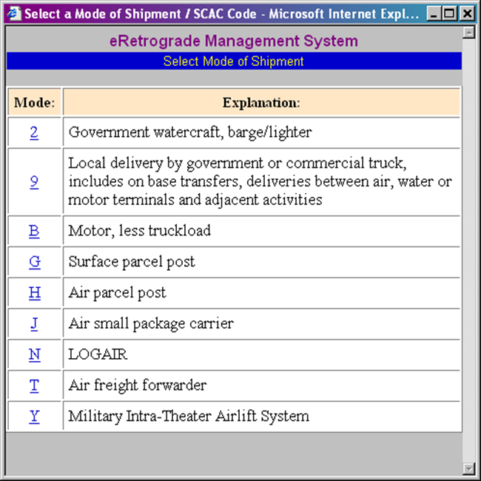
Update POS/POD
CLICK HERE
Notes:
There are also two links on the “Enter Proof of Shipment Information” screen:
Clicking on the “Mode” link will bring up a pop up box that allows you to select the Mode of Shipment from a pre-populated list. You can enter the MODE manually, but NITA will validate the Mode to ensure validity.

Slide 22
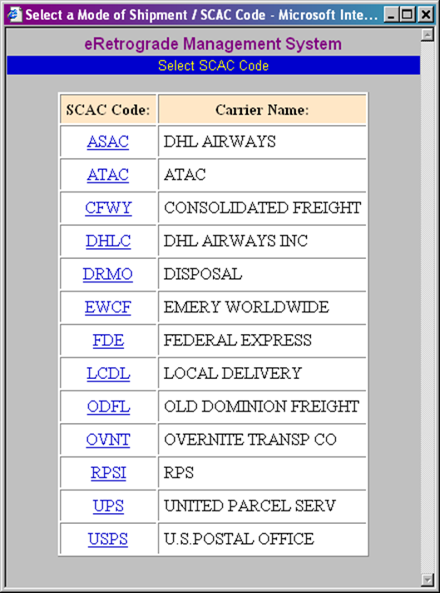
Update POS/POD
CLICK HERE
Notes:
Clicking on the “SCAC Code” link will bring up a pop up box that allows you to select the SCAC, (Standard Carrier Alpha Code), from a pre-populated list. As with the Mode field, you can enter the SCAC manually, but NITA will validate the SCAC to ensure validity.
Although, (as mentioned earlier), the fields that are mandatory for all shipments are marked with an asterisk, there are other fields that will become mandatory when specific Modes Of Shipment are chosen, (refer to the POS Guide included with this training). If an entry is not made in any mandatory field, ****next slide****

Slide 23
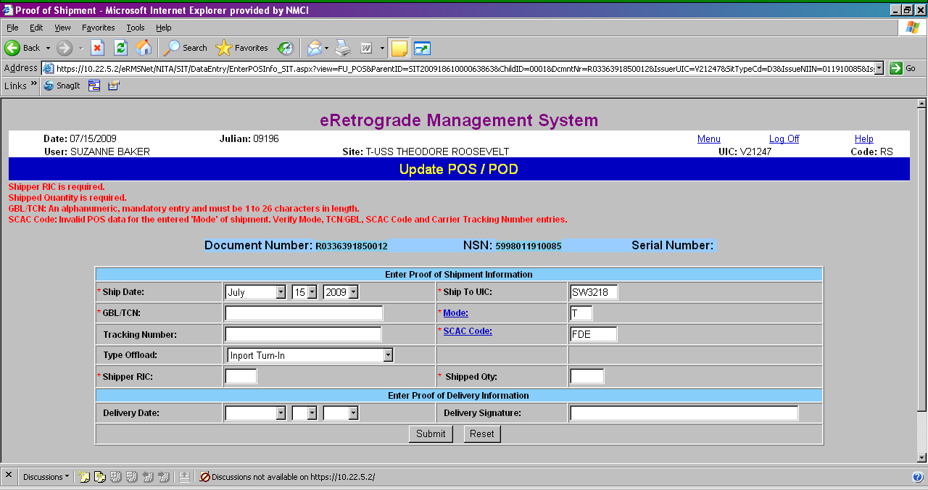
Update POS/POD
Notes:
you will receive an error message like the one above.

Slide 24
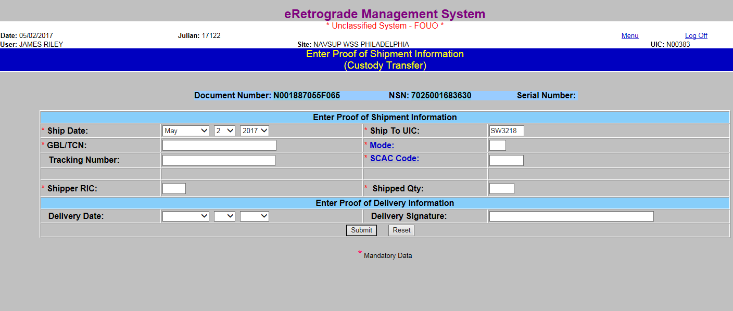
Update POS/POD
CLICK HERE
Notes:
Once you have completed all of the necessary fields, click on the “Submit” button to complete updating POS/POD.

Slide 25
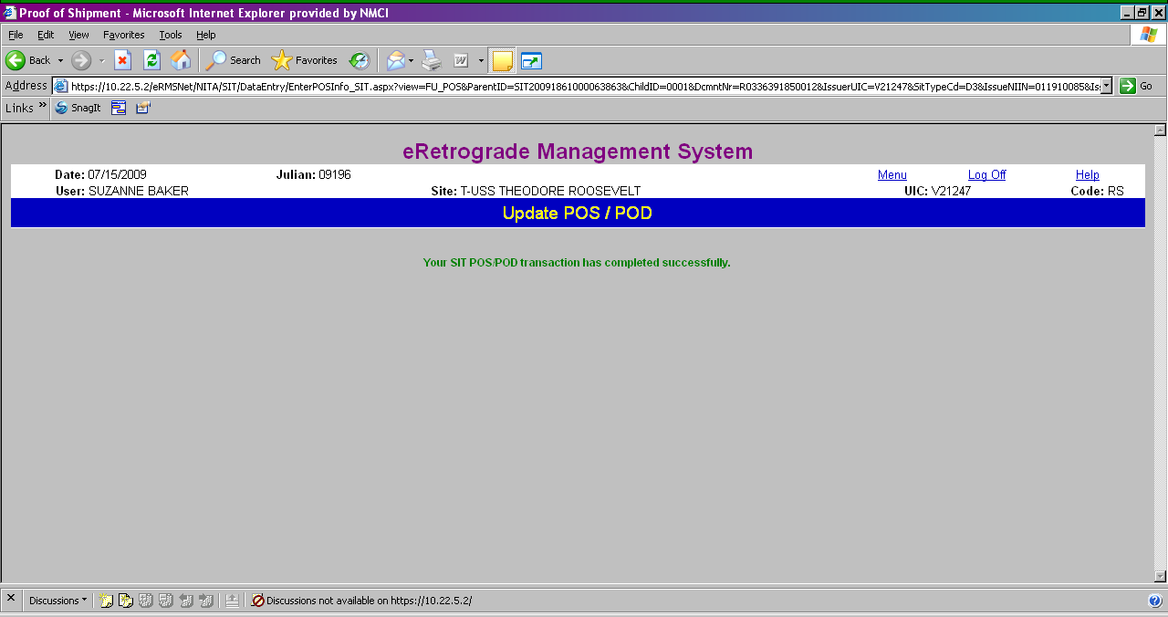
Update POS/POD
Notes:
Transportation Data is immediately updated.
SIT Tracking is updated real time.
Once your SIT POS/POD transaction has been completed successfully, Transportation Data is immediately updated, and ****next slide*****

Slide 26
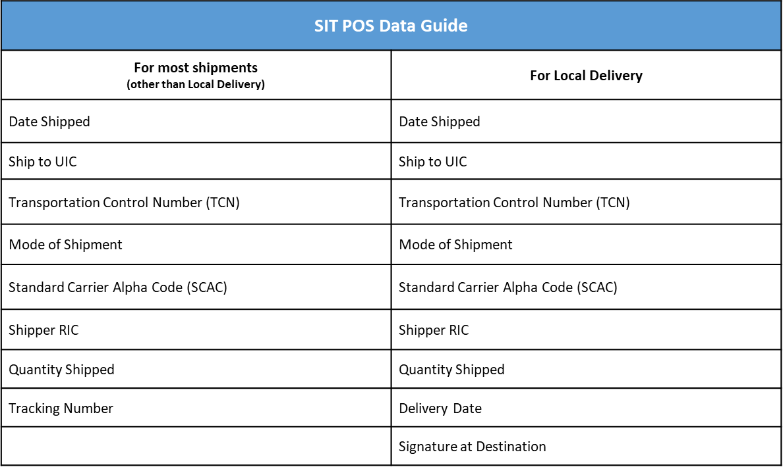
SIT POS Data Guide

Slide 27
SIT Points of Contact
Monica Hodson (CAV SIT Team Lead) - monica.a.hodson.civ@us.navy.mil
Jason Bolen (CAV SIT Team Lead) - jason.c.bolen.civ@us.navy.mil
Sara Grafstrom (Classified SIT Team Lead) - sara.grafstrom.civ@us.navy.mil
Bridgette Orr (SIT Supervisor) - bridgette.p.orr.civ@us.navy.mil

